Slide 1


The impact of COVID-19
on the recruitment market
Simon Wicks
CEO

Slide 2
Butler Rose GP – last 13 months
% of March ’20 GP

Slide 3

Common Market Perceptions
Supply outstrips demand (furloughs, redundancies, recruitment freezes).
There must be lots of good finance candidates to choose from.
Competition for good finance candidates must be lower than before.
Candidates will bite my hand off for a job!

Slide 4

Common Market Perceptions
Supply outstrips demand (furloughs, redundancies, recruitment freezes).
There must be lots of good finance candidates to choose from.
Competition for good finance candidates must be lower than before.
Candidates will bite my hand off for a job!

Slide 5

The Reality
Less finance candidates coming actively to market – particularly higher calibre.
More offers being turned down than ever before – by some way.
Better counter offers being made by existing employers.
Candidates generally very nervous about moving and being quite demanding.

Slide 6

What can you do?
Reach a wider audience
  Well-written adverts
  Tap into a passive candidate pool
  Remote role?
Interview to secure
  Prepare
  Find out what the candidates want
  Sell the opportunity – role, company, benefits, development
  Challenge – but be ‘nice’!
  Take them on a ‘concise journey’
Make successful offers
  Reiterate why
  Make them feel valued
  Make a fair offer – establish at the outset
Use an experienced, consultative finance recruiter

Slide 7

Flexible/home working
Here to stay.
Extremely high on many candidates’ agendas.
One of the major reasons for offers now being turned down.
If you’re not offering it contractually for the long-term, you should seriously consider it.

Slide 8








Thank you. Questions?
s.wicks@butlerrose.com
+44 7884 733704
www.butlerrose.com

Slide 9




Practical Implications of a Covid-19 Year End and Audit; and Changes to Financial Reporting Following the UK’s Withdrawal from the EU
Alan Endersby, Partner
Streets Chartered Accountants
@Streetsacc

Slide 10
Practical Implications of a Covid-19 Year End and Audit
Streets Chartered Accountants
@Streetsacc

Slide 11
Key Areas For Consideration
Companies House filing Extensions
Government funding and assistance
Going concern
Reporting within financial statements

Slide 12
Companies House Filing Extensions
Automatic extension ended on 5 April 2021
Filing extension is available after 5 April 2021, but will need to be applied for
Only one filing extension is permissible for an accounting and the extension cannot take the filing date later than 12 months after the end of the accounting period
Remember this is a Companies House extension, not HMRC, therefore tax liabilities are still due after 9 months and 1 day

Slide 13
Other Potential Impacts of Companies House Filing Extension
Group Companies – Could be an impact on audit exemptions and group accounts exemptions if year ends of parents and subsidiaries do not align
Banking and Contractual Covenants – Ensure the wording of covenants don’t required 9 month filings

Slide 14
Government Funding and Assistance
Coronavirus Job Retention Scheme (CJRS):
It is a government grant
Recognised once reasonable assurance that conditions have been met and grant will be awarded
Preferable to use the accrual model for recognition i.e. match the income to the costs
Income shown separately on the face on the P&L as Other Income
Additional accounting policy for government grants will be required

Slide 15
Government Funding and Assistance
Coronavirus Business Interruption Loans (CIBILS) & Bounce Back Loans:
Interest Free Period – Expected interest should be calculated and recognised as an interest expense and government grant income.
Arrangements Fee

Slide 16
Other Covid-19 Funding and Assistance
Rates Relief – This is recognised as a reduction in the expense, not as a government grant
Small Business Grants – Recognised immediately as government grant income
Rent Holiday – Where covid-19 related, the reduction is recognised in the period that the benefit occurs and not spread over the term of the lease

Slide 17
Going Concern
The assessment of going concern is made at the date that the directors approve the annual or half-yearly financial statements, and takes into account the relevant facts and circumstances at that date.
Financial statements are prepared on a going concern basis unless the management or directors either intend to liquidate the entity or cease operations, or have no realistic alternative but to do so.
Under the Financial Reporting Standard for Smaller Entities (FRSSE), UK Generally Accepted Accounting Principles (UK GAAP) and International Financial Reporting Standards (IFRS) directors are required to satisfy themselves that it is reasonable for them to conclude that it is appropriate to prepare financial statements on a going concern basis.

Slide 18
Indicators of Going Concern Issues
Decrease in turnover
Loss in the year
Net current liabilities / Net liabilities
Loss of key staff without replacement
Loss of key customs
Borrowings approaching maturity without realistic prospects of renewal or repayment

Slide 19
What Can You Do To Prove You Are a Going Concern?
Budgets and cashflows
Sensitivity analysis and flexible budgets
Stress testing of both budgets and cashflows
Managements minutes showing discussions and considerations
Group support

Slide 20
BREXIT – Reflections On Implications For Financial Reporting
Streets Chartered Accountants
@Streetsacc

Slide 21
Impact of Brexit
Brexit implications are likely to vary significantly from business to business. Challenges might be:
Supply-chain
Regulatory matters
Labour mobility
Custom tariffs

Slide 22
Narrative Reporting
Key location for the disclosure of the impact of Brexit will be in the Strategic Report
A strategic report is applicable to all companies except ‘small’ companies under UK Law
The strategic report needs to cover:
    Financial impact of Brexit on the current year’s performance
    Principal risks and uncertainties
    Information on the main trends and factors likely to affect the future development

Slide 23
Financial Reporting
Measurement Consideration
    Inventories
    Foreign exchange
    Deferred tax assets
    Measurement of non-financial assets and financial instruments

Slide 24
Going Concern
Brexit brings with it an element of uncertainty for many, and for some there may be uncertainty around the ability of the company to continue as a going concern.
Given the increased likelihood of material uncertainties and the possibility that some accounts will be prepared on a basis other than going concern, auditors are likely to view going concern as a heightened and/or significant risk area. A new auditing standard also requires a more comprehensive and structured auditor risk assessment as a starting point when considering going concern.

Slide 25
Company Law
Small and medium sized companies and groups
Exemption from preparing group accounts for intermediate parents
Change of accounting framework
Dormant companies
Accounting reference date

Slide 26
Practical Implications of a Covid-19 Year End and Audit; and Changes to Financial Reporting Following the UK’s Withdrawal from the EU
Alan Endersby, Partner
Email aendersby@streetsweb.co.uk
Streets Chartered Accountants
@Streetsacc

Slide 27
Corporate tax planning in light of the Budget 2021
Luke Prout, Corporate Tax Partner
Streets Chartered Accountants
@Streetsacc

Slide 28
Increase in Corporation Tax
From 01 April 2023
Will increase to 25% (Profits over £250,000)
Remain at 19% (Profits below £50,000)
Tapered 19-25% (Profits £50,001 - £250,000)
Marginal relief
Fraction 3/200
Marginal Rate 26.5%

Slide 29
Increase in Corporation Tax
Year | Starting Profit Threshold | Small Rate Profit Threshold | Starting Rate of Tax | Small Profit Rate of Tax | Standard Rate of Tax
2000 | 10,000 | 300,000 | 10% | 20% | 30%
2001 | 10,000 | 300,000 | 10% | 20% | 30%
2002 | 10,000 | 300,000 | 0% | 19% | 30%
2003 | 10,000 | 300,000 | 0% | 19% | 30%
2004 | 10,000 | 300,000 | 0% | 19% | 30%
2005 | 10,000 | 300,000 | 0% | 19% | 30%
2006 | - | 300,000 | - | 19% | 30%
2007 | - | 300,000 | - | 20% | 30%
2008 | - | 300,000 | - | 21% | 28%
2009 | - | 300,000 | - | 21% | 28%
2010 | - | 300,000 | - | 21% | 28%
2011 | - | 300,000 | - | 20% | 26%
2012 | - | 300,000 | - | 20% | 24%
2013 | - | 300,000 | - | 20% | 23%
2014 | - | 300,000 | - | 20% | 21%
2015 | - | N/A | - | 20% | 20%
2016 | - | N/A | - | 20% | 20%
2017 | - | N/A | - | 19% | 19%
2018 | - | N/A | - | 19% | 19%
2019 | - | N/A | - | 19% | 19%
2020 | - | N/A | - | 19% | 19%
2021 | - | N/A | - | 19% | 19%
2022 | - | N/A | - | 19% | 19%
2023 | - | 50,000 | - | 19% | 25%

Slide 30
Increase in Corporation Tax
Option 1 Option 2
£
Profits 200,000
Tax at 25% 50,000
Less MR (250k-P)
£50,000 x 3/200 (750)
Tax due 49,250 24.62%
£
Profits 200,000
50,000 19% 9,500
150,000 26.50% 39,750
Tax due 49,250
24.62%

Slide 31
Marginal rates explained
Lower Limit £50,000 19% £9,500
Upper Limit £250,000 25% £62,500
Marginal £200,000 £53,000
Marginal rate 26.50%

Slide 32
Increase in Corporation Tax
Associated companies (From April 2023)
A company is associated with another company at a particular time if, at that time or at any other time within the preceding 12 months:
  One company has control of the other.
  Both companies are under the control of the same person or group of persons (and their associates)
    Spouses (and civil partners), but not if divorced.
    Blood relatives.
    An individual beneficiary will be associated with a trustee or settlor of a trust.
Substantial commercial interdependence (ignore associates)

Slide 33
Associated companies
Group
Controlled
Hold co
Shareholder
Trade co
Trade co 1
Trade co 2

Slide 34
Associated companies - SCI
Are these associated?
Both controlled by the same persons and associates
Financial, Economics an organisational Links such as;-
  Loans
  Indirect activities
  Personal guarantees
  Common customers
  Same type of business
  Employees
  Premises
  Equipment
 | A Limited | B Limited
Mr Bloggs | 100%
Mr Bloggs Son |  | 100%

Slide 35
Super deduction and other temporary first year allowances
From 01 April 2021 to 31 March 2023
Only available to companies
Applies to plant and machinery and special rate items
New assets only (not second hand) – Demonstrators OK
Not cars, connected persons, gifts, year of cessation
Contracts entered on or after 03 March 2021
SBA’s and AIA still available

Slide 36
Super deduction and other temporary first year allowances
Leased assets
Leasing to subsidiary companies – NO
Short term accommodation and trades (Hotels, care homes, serviced office’s, retail, restaurant, leisure) if a trade – Possibly but further clarification
Commercial tenants – NO
Area of clarification needed

Slide 37
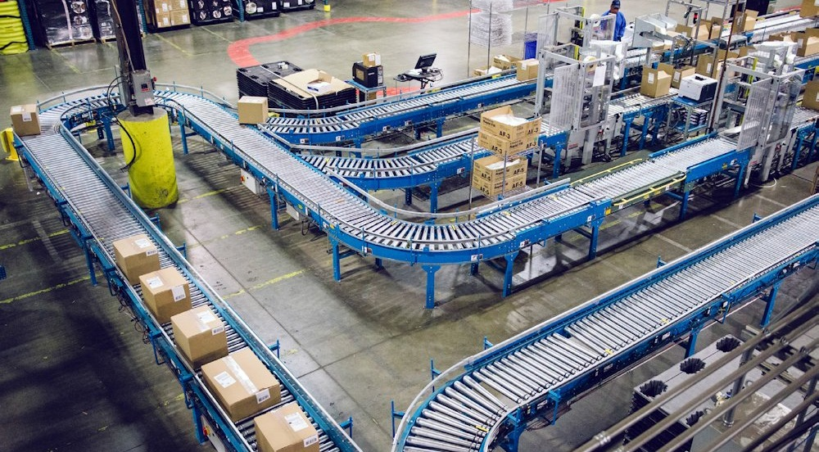
Super deduction – Plant and machinery
130% relief on expenditure
No apportionment for periods straddling 01/04/2021
Disposals – treated as receipts
Before April 2023 130% must be paid back
After only 100%
Watch periods covering 01/04/2023 – 100% - 130%

Slide 38
Super deduction example
Factory installs production Line
Cost in 2022 - £3.5M
Tax relief Year 1 - £3.5M x 130% x 19% = £864,500
Would have been - £275,500
Real cash saving - £589,000

Slide 39

Special rate assets – 50%
Hot/cold water systems, heating systems, lifts, electrical systems
Currently 6% WDA
Now 50% FYA
AIA on the balance £1M
Normal disposal rules apply
ECA’s was abolished from 2020, so some reprieve

Slide 40
Embedded allowances
Offices – Hi spec 30-40%
Offices – Low Spec 20-30%
Warehouses (with small office) 10-20%
Care homes 30-50%
Factories 25-35%
Car showrooms 30-40%
Restaurants 35 – 45%
Holiday parks 30-50%
Renewable energy parks – up to 80%
Cold and chilled stores – up to 90%

Slide 41
Temporary extension of loss carry back
AP ending between 01/04/2020 – 31/03/2020 – companies
2020/21 & 2021/22 for self employment and unincorporated businesses
Carry back PY1, PY2 & PY3
Cap £2,000,000 for both companies and unincorporated businesses per tax year
£200,000 de-minimis for a company (claims made before filing the return)
HMRC will not repay until Finance Bill receives Royal Assent
Possibility to claim under current rules for PY1 – No Cap

Slide 42
Corporate tax planning in light of the Budget 2021
Luke Prout, Corporate Tax Partner
Email lprout@streetsweb.co.uk
Streets Chartered Accountants
@Streetsacc

Slide 43
Doug Greer
Transactional finance
Bedfordshire and Hertfordshire

Slide 44
Northern Home Counties Division
The Team
Doug Greer – Transactional finance Bedfordshire and Hertfordshire
M: 07385 391729 d.greer@butlerrose.com
Helen Hopley – Mid-senior level finance, A1 corridor
M: 07385 391706 h.hopley@butlerrose.com
Michael Greer - Mid-senior level finance, M1 corridor
M: 07385 391636 m.greer@butlerrose.com
Consultancy Services
• Market Mapping • Headhunting
• Interview Support • Retention Techniques
• Job Analysis and consultation • Salary Benchmarking
Recruitment Services
• Executive Finance / Qualified • Tax and Treasury
• Part & Newly Qualified Accountants • Interim and change managers
• Qualified by Experience • Transactional finance
• Analysts and Business Partners • Payroll
We are excited to offer a first-class accountancy and finance recruitment service within the Northern Home Counties and in doing so look forward to working with you and your business over the coming months and years…

